Slide 1
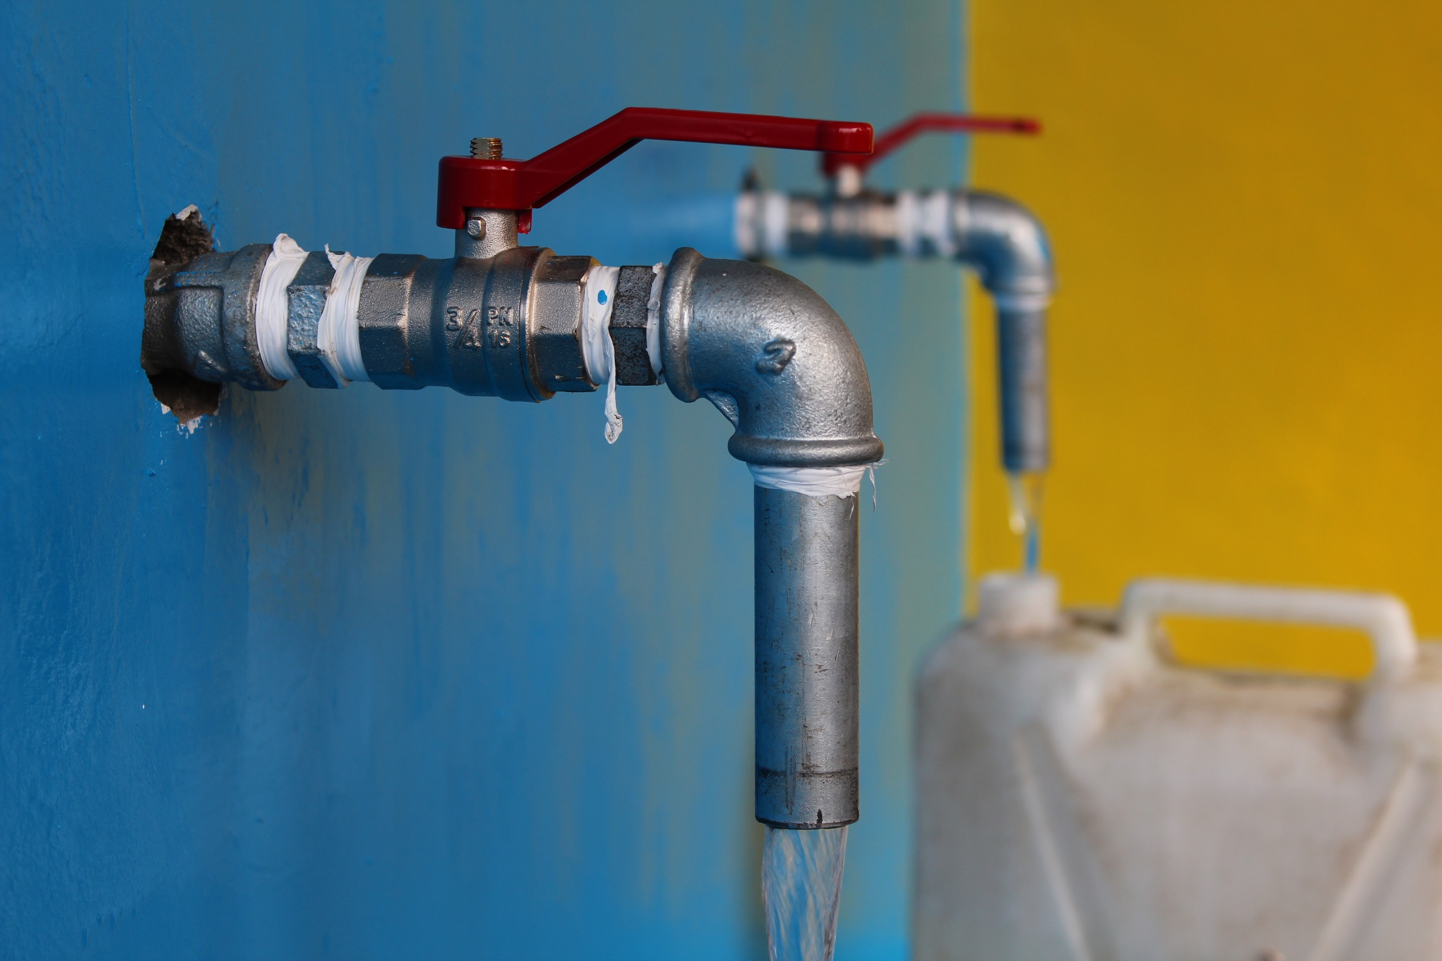
FLINT WATER:
“What Happens When Regulations Fail?”
2016 WORLD WATER DAY EVENT
Join CGSW for:
An interactive, multidisciplinary discussion with local experts examining the environmental, human rights and regulatory significance of Flint water contamination and other water crises in America
WEDNESDAY, MARCH 23, 2016
4:00 PM – 6:00 PM
CNR 1000
Featured speakers :
Dr. Amy Kirby – Research Assistant Professor, Hubert Department of Global Health
Dr. Julie Clennon – Instructor, Biostatistics and Bioinformatics
Dr. Dabney Evans – Assistant Professor, Hubert Department of Global Health; Director of the Center for Humanitarian Emergencies and Institute of Human Rights.
Distinguished Panelist
Dr. Parmi Suchdev - Associate Professor of Pediatrics and Global Health at Emory University and Medical Epidemiologist with the CDC Nutrition Branch.
Plus special guests
Reception at 4:00 PM – Speakers & Panel Discussion 4:30 PM
#WorldWaterDay

